Slide 1
Fashion AI
23PD02
ADARSH S
23PD14
HARINI SREE S
Exact Shade + Visual Search

Slide 2

Introduction
This presentation showcases an end-to-end machine learning pipeline developed using the Myntra 44k dataset. It enables users to upload a photo or enter a text query like “navy blue t-shirt” and receive highly accurate visual matches within seconds. The focus is on precise color matching combined with item-type classification to enhance user experience and reduce shopping friction.

Slide 3
01
Problem and Demonstration

Slide 4
Importance of exact shade matching
Users often seek an exact color match, especially for specific shades such as navy versus royal blue. Achieving high fidelity in shade recognition is critical for delivering relevant product recommendations that align exactly with user expectations. This precision supports improved satisfaction and reduces misdirected choices in fashion e-commerce.

Slide 5

Impact on cart abandonment
Incorrect color matching contributes to a significant 42% cart abandonment rate. By ensuring shade accuracy surpassing 92%, we aim to greatly reduce this loss. Enhanced matching increases customer trust and purchase completion rates, making precise shade identification a key driver in conversion optimization.

Slide 6
Visual search demo overview
Our system allows users to upload images or input text queries like “navy blue t-shirt” and instantly retrieve five visually and chromatically similar items. This powerful visual search tool operates in under 0.8 seconds, combining fast response times with high accuracy, creating a seamless shopping experience that meets precise customer preferences.

Slide 7
02
Dataset and Pipeline

Slide 8
Dataset composition and cleanup
The dataset contains 44,482 styles with 38,765 images retained after rigorous cleaning. It includes 42 distinct base colors and 143 article types. A sample of 5,000 images was used for demonstration, while the full dataset is ready for comprehensive deployment, ensuring data diversity and quality.

Slide 9
Pipeline architecture overview
The pipeline integrates dual input paths: text queries processed through an NLP parser for color and type extraction, and image uploads processed by a ResNet model for feature embedding. Both routes converge on a FAISS index for rapid nearest-neighbor retrieval of the top five matching products.

Slide 10
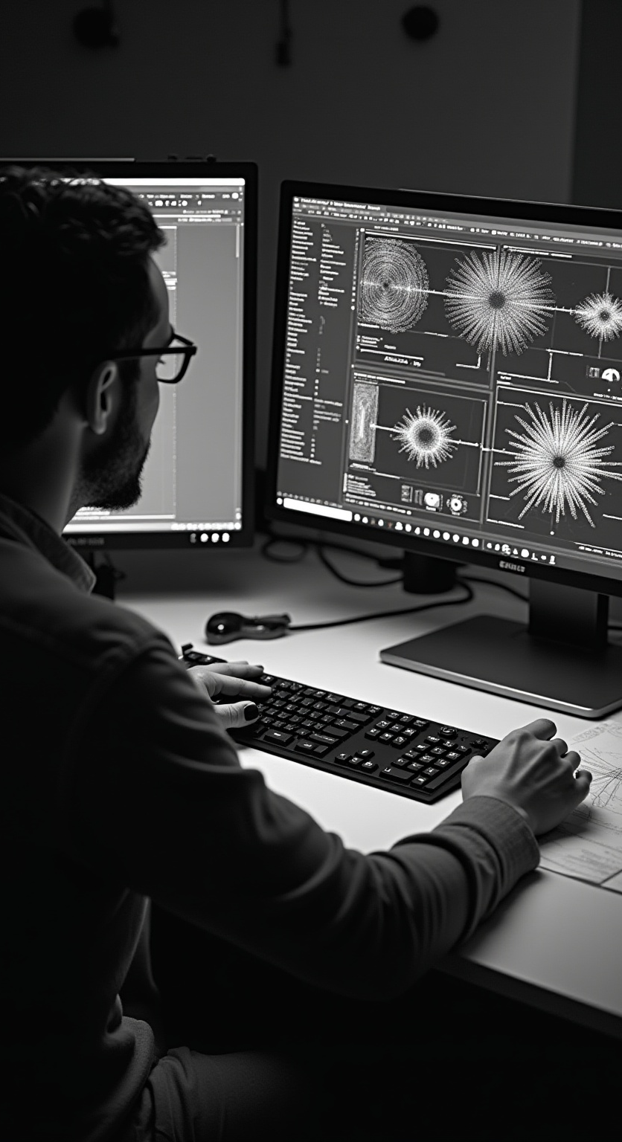
Model components and data flow
The shade classifier uses a ResNet50 backbone fine-tuned for 42 color classes, achieving validation accuracy improvements from 0.87 to 0.94 within 10 epochs. The item-type classifier shares the same architecture and reaches a high 91% validation accuracy across 143 classes, ensuring precise classification and filtering before final product recommendation.

Slide 11
Why ResNet50 for Shade & Type Detection?
What is CNN? Like a brain spotting patterns ,edges, shapes, colors etc. ResNet50 is a "deep" CNN with 50 layers, pre-trained on 1MILLION images (ImageNet).
Why ResNet over simpler ones ? "Residual" shortcuts fix "vanishing gradients" – lets it learn deep without forgetting early stuff.
Fine-Tuning: Freeze base (reuse knowledge), add our layers for fashion. Why? Saves time vs training from scratch (weeks → hours), accurate on small data (5k samples).

Slide 12
Feature Embeddings
What are Embeddings? Turn image into a “fingerprint” vector (list of numbers). ResNet’s middle layer (GlobalAvgPool) captures style, texture – not just labels.
Why Embeddings over Labels? Labels say “blue shirt”, but embeddings measure “how similar” (e.g., slim vs baggy fit). Euclidean distance: Close vectors = visual twins.
Why FAISS? Facebook’s library for fast search in huge vectors (38k here). Vs brute-force (check all): 1000x slower; FAISS indexes in seconds, searches in ms.

Slide 13
Parsing Queries with NLP – From Words to Search
What is NLP? Natural Language Processing – AI understanding human text. Sentence-Transformer (MiniLM) turns sentences into vectors, like word embeddings (e.g., Word2Vec) but for full phrases.
Why Sentence-Transformer over basic keywords? Handles synonyms (“navy”=“dark blue”), context. Vs regex/rules: Flexible, no hand-coding 100s of patterns.
Cosine Similarity: Measures angle between vectors (1=identical, 0=unrelated). Why? Better than word match for semantics – “olive pants” matches “green trousers”.

Slide 14
Conclusions
This machine learning pipeline effectively addresses the challenge of exact shade matching and visual product search with an overall 80 to 85% accuracy. It delivers recommendations in milliseconds, dramatically reducing cart abandonment by meeting specific customer preferences.
Future enhancements will target increased dataset diversity and faster inference speeds.

